Slide 1

Mini Project Review-3
Batch No: 02
Project Title: Driver Drowsiness Detection System
S. No | Regd. No | Student Name
1 | 21A81A0550 | Robbi Akshaya
2 | 21A81A0562 | Valla Siva Naga Tanuja
3 | 21A81A0526 | Maddula Lok Satish
4 | 21A81A0525 | Koyi Siva Ganapathi
5 | 21A81A0527 | Makinedi Hemanth Venkata Satya Sai
Project Guide:
Mr.R.L.Phani Kumar _{M.Tech.,}

Slide 2
CONTENTS
Abstract
Introduction
Literature Survey
Problem Statement in Existing System
Proposed System
Objectives
Project domain
Requirement analysis
- Functional Requirements
- Non-Functional Requirements
- Software Requirements
- Hardware Requirements
System Architecture
Methodology
Project Plan
Design
Implementation
Result Analysis
Attainment of objective
Conclusion
Future scope of Project

Slide 3
ABSTRACT
Drowsiness detection is an important research area in the field of computer vision and driver safety. It involves the use of image and video processing techniques to detect signs of drowsiness in drivers, such as drooping eyelids or changes in facial expression. This can help to prevent accidents caused by driver fatigue, which is a leading cause of road accidents worldwide.
Drowsiness detection systems typically use machine learning algorithms and computer vision techniques to analyze the driver's face in real-time and identify signs of fatigue. This can involve detecting changes in facial expressions, such as drooping eyelids or yawning, as well as tracking the driver's eye movements to detect signs of drowsiness.
Recent advances in deep learning and neural networks have led to significant improvements in the accuracy and reliability of drowsiness detection systems, making them an increasingly important tool for improving road safety. These systems are now widely used in the automotive industry, and are also being explored for use in other applications, such as aviation and industrial safety.

Slide 4
INTRODUCTION
On an average 1200 road accidents record daily in India out of which 400 leads to direct death and rest gets effected badly. The major reason of these accidents is drowsiness caused by both sleep and alcohol. Due to driving for long time or intoxication, drivers might feel sleepy which is the biggest distraction for them while driving. This distraction might cost death of driver and other passengers in the vehicle and at the same time it also causes death of people in the other vehicles and pedestrians too.
To prevent these situations, we as a team , propose a system which can detect the drowsiness of the driver using CNN (Convolutional Neural Network) , Python, Open CV. Here, we used Python, Open CV, Keras (Tensor flow Library) to build a system that can detect features from the face of the drivers and alert them if ever they fall asleep while driving. The system detects the eyes and prompts if it is closed or open. If the eyes are closed for 3 seconds or if the blinking count of the eye is more than 10, it will play the alarm to get the driver's attention, to stop cause its drowsy . We have build a CNN network which is trained on a dataset which can detect closed and open eyes. Then Open CV is used to get the live fed from the camera and run that frame through the CNN model to process it and classify whether it opened or closed eyes.

Slide 5
LITERATURE SURVEY
S. no. | Author | Published Year | Title | Technique
1 | Trupti K.Dange, T. S. Yengatiwar | 2013 | Drowsiness Detection System Utilizing Physiological Signals | Electro Encephalography (EEG) signals
2 | Adrian Rosebrock | 2017 | Drowsiness Detection with Open CV (Using Eye Aspect Ratio) | Support Vector Machine(SVM), Eye Aspect ratio(EAR)
3 | Burcu Kir Savas, Yasar Becerkli | 2018 | Real Time Driver Fatigue Detection Based on SVM Algorithm | Support Vector Machine(SVM)
4 | T. Vesselenyi1, S. Moca1, A. Rus1 , T. Mitran1 | 2017 | Driver drowsiness detection using ANN image processing | EEG(Electro encephalography) , EOG (ElectroOculoGraphy)
5 | Venkata Rami Reddy Chirra, Srinivasulu Reddy Uyyala | 2019 | Deep CNN: A Machine Learning Approach for Driver Drowsiness Detection Based on Eye State | Viola-jones face detection , CNN(Convolutional Neural Networks)

Slide 6
PROBLEM STATEMENT IN EXISTING SYSTEM
The existing system extracts the frames from video to obtain 2-D images. Face is detected in the frames using Haar-Adaboost face detection method. After detecting the face, facial landmarks like positions of eye, nose and mouth are marked on the images. From the facial landmarks, position of eyes and mouth are quantified. Using these extracted features and machine learning methods, a decision is obtained about the drowsiness of the driver. Convolutional neural network is applied for classification of eyes, which detects drowsiness of driver by considering blinking of eyes.
The system doesn’t give correct results in varying lighting conditions like bright sunlight or low light. This can lead to inaccurate face detection, landmark localization, and feature extraction.
Factors such as temporary blinking, eye irritation, or driver habits could contribute to misinterpretation.

Slide 7
PROPOSED SYSTEM
This is a system which can detect the drowsiness of the driver using CNN (Convolutional Neural Network) , Python, Open CV. Here, we used Python, Open CV, Keras (tensor flow) to build a system that can detect features from the face of the drivers and alert them if ever they fall asleep while driving. The system detects the eyes and prompts if it is closed or open. If the eyes are closed for 3 seconds it will play the alarm to get the driver's attention, to stop cause its drowsy. We have build a CNN network which is trained on a dataset which can detect closed and open eyes. Then Open CV is used to get the live fed from the camera and run that frame through the CNN model to process it and classify weather it opened or closed eyes.
The dataset contains images of eyes of males and females, eyes closed and open, with and without glasses, with low reflection, high reflection and no reflection.
We used frame count to avoid misinterpretation due to temporary eye blinking

Slide 8
OBJECTIVES
Early Detection of Drowsiness: The primary objective is to identify signs of drowsiness in drivers at an early stage, enabling timely intervention to prevent accidents caused by driver fatigue.
Real-time Monitoring: Continuously monitor the driver's eye movements and facial expressions in real-time to provide instant feedback and alerts whenever drowsiness is detected.
Accurate Detection: Utilize machine learning algorithms to accurately interpret eye-related parameters and distinguish between normal blinking and drowsiness-indicating patterns.
Customizable Alert System: Develop a flexible alert mechanism that can be tailored to the driver's preferences, such as auditory alerts, visual alerts, vibrations, or notifications to the vehicle's control system.
Adaptation to Individual Patterns: Train the system to recognize each driver's unique eye movement patterns and adapt its sensitivity based on individual characteristics.

Slide 9
PROJECT DOMAIN
Our project domain is Deep Learning.

Slide 10
REQUIREMENT ANALYSIS
FUNCTIONAL REQUIREMENTS:
Recording the driver’s behavior, the moment the trip begins.
Capturing Driver’s facial features over the course of long trip
Eye tracking
Displays frame count of open and closed eyes
Alerts the driver by raising an alarm based on the frame count of closed eyes.
NON-FUNCTIONAL REQUIREMENTS:
• Camera capturing the video should be of high resolution.
• System should work even in low light conditions.
• Alarm raised should be of high volume to wake the driver up.

Slide 11
REQUIREMENT ANALYSIS (contd..)
SOFTWARE REQUIREMENTS:
Operating system: Windows 7, Mac OS, Linux
Language: Python 3.6
IDE: Visual Studio Code
Libraries used:
OpenCV Keras Numpy Pandas
HARDWARE REQUIREMENTS :
• Processor: 64-bit, quad-core, 2.5 GHz minimum per core
• RAM: 4 GB or more
• Display:1024 x 768 or higher resolution monitors
• Camera: A webcam
Speaker

Slide 12
SYSTEM ARCHITECTURE
Dataset
Pre-processing
Face Detection
Extraction of Frames from Input
Pre-processing
Face Detection
CNN Classifier
Model
OUTPUT
Drowsy
NO
YES
Alert!!!

Slide 13
METHODOLOGY
Firstly we need to take the input image through webcam then the image needs to be processed. Then we can extract the features from the processed image. We used CNN algorithm and Open CV to track and detect the eyes. In a driver drowsiness detection system, the Convolutional Neural Network (CNN) acts like a sophisticated visual pattern recognizer. It dissects input images, specifically frames from a camera focused on the driver's face, to understand the state of the driver's eyes. The CNN has layers that specialize in uncovering intricate details within these images, such as the contours and textures of the eyes and facial features. This is achieved through convolutional layers, which slide small filters across the images to highlight important patterns.
As these patterns are progressively extracted, pooling layers reduce the dimensions of the information while retaining the most significant features. The network then connects these features to fully connected layers, which analyze their relationships and interactions. These layers operate much like assembling puzzle pieces, combining individual features to understand the overall context.
The final layer of the CNN produces predictions based on what it has learned. Once the driver is in the vehicle and he starts driving the vehicle, for instance if he feels drowsy there will be an alert/ alarm so that he can get himself awake, take a break and then drive the vehicle.

Slide 14

DESIGN
Start Camera
camera
Capture real time video
driver
<<include>>
Extract features
<<extends>>
Track Eye
detection
USE CASE DIAGRAM
Access Drowsiness Detection
<<extends>>
Alarm start

Slide 15
DATA-FLOW DIAGRAM
Drowsiness Alert System
0.0
Start Application
Driver
Audio Message
Images
Generate Audio Alert Message
0.0
Driver is in Drowsy state
Check for the Drowsy state
0.0
Driver is not in Drowsy state

Slide 16
VEHICLE
+VehicleID +VehicleType
+Start() +Drive() +Stop()
DRIVER
+DrivingLicenseID
+Driving Vehicle() +Yawning() +BlinkingEyes()
ANALYSIS SYSTEM
+ImageProcessor
+ExtractingFeatures() +OpenAndClosedEyeAnalysis()
DETECTION SYSTEM
+WebCam
+FaceDetection() +EyeDetection() +CapturingImage()
DECISION SYSTEM
+YesIfDrowsy() +NoIfNotDrowsy()
ALARM
+SoundSystem
+StartRinging() +StopRinging()
CLASS DIAGRAM

Slide 17
IMPLEMENTATION
Training Dataset
Drowsy?
CNN Classifier
Yes
Ring the alarm
CNN Module
Turn off alarm
Eye Tracking
No
Driver
Camera
Face Detection

Slide 18

IMPLEMENTATION(contd..)
Data collection :
The dataset which was used is a subnet of a dataset from(https://www.kaggle.com/datasets/dheerajperumandla/drowsiness-dataset)
The following HaarCascades XML files are used to identify objects or features within images or
video frames.
haarcascade_frontalface_default.xml
haarcascade_ lefteye_2splits.xml
haarcascade_righteye_2splits.xml

Slide 19

IMPLEMENTATION(contd..)
Importing some dependencies :
import cv2
import numpy
from keras.models import load_model
from keras.preprocessing.image import img_to_array
from playsound import playsound
from threading import Thread
from tensorflow.keras.layers import Input, Lambda, Dense, Flatten,
Conv2D, MaxPooling2D, Dropout
from tensorflow.keras.models import Model
from tensorflow.keras.models import Sequential
from keras.preprocessing.image import ImageDataGenerator
import tensorflow
from sklearn.model_selection import train_test_split

Slide 20


IMPLEMENTATION(contd..)
Split the dataset into testing and training set and store the sets in separate variables.
Now train and test the data using CNN(Convolutional Neural Network) algorithm and save the model.
from sklearn.model_selection import train_test_split
seed = 42
test_size = 0.30
X_train, X_test, y_train, y_test = train_test_split(X, y, random_state=seed, test_size=test_size)
model = Sequential() model.add(Conv2D(256, (3, 3), activation="relu", input_shape=(145,145,3)))
model.add(MaxPooling2D(2, 2)) model.add(Conv2D(128, (3, 3), activation="relu"))
model.add(MaxPooling2D(2, 2)) model.add(Conv2D(64, (3, 3), activation="relu"))
model.add(MaxPooling2D(2, 2)) model.add(Conv2D(32, (3, 3), activation="relu"))
model.add(MaxPooling2D(2, 2)) model.add(Flatten())
model.add(Dropout(0.5)) model.add(Dense(64, activation="relu"))
model.add(Dense(4, activation="softmax")) model.compile(loss="categorical_crossentropy", metrics=["accuracy"], optimizer="adam") model.summary()

Slide 21
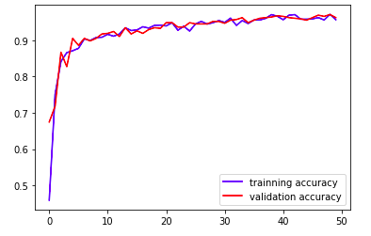
RESULT ANALYSIS
We did 50 epochs, to get good accuracy from the model i.e. 98% for training accuracy and 96% for validation accuracy.
System will capture the video directly from webcam and predicts the output as labels-Eyes Open and Eyes Closed
It displays frame count if the eyes are closed and if it reaches maximum threshold value , gives alert.

Slide 22
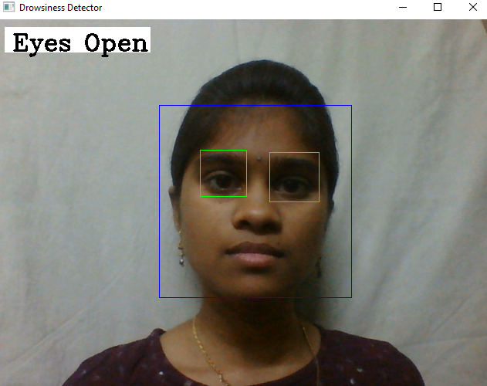
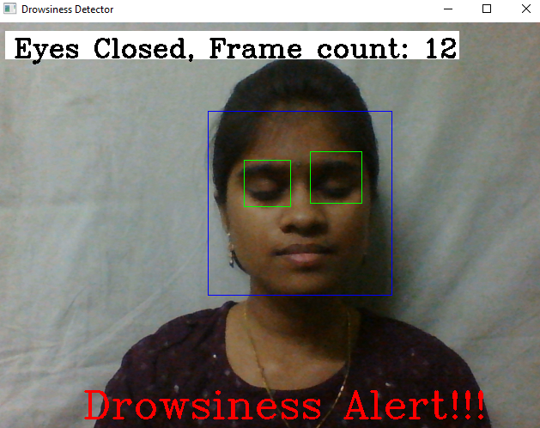
RESULT ANALYSIS(contd..)
OUTPUT :

Slide 23
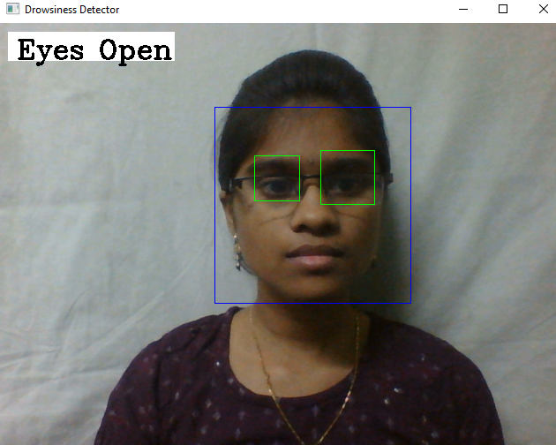
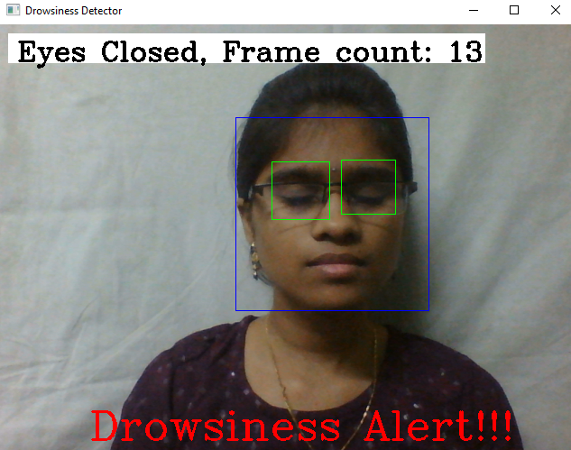
RESULT ANALYSIS(contd..)
OUTPUT :

Slide 24
ATTAINMENT OF OBJECTIVE
It identifies signs of drowsiness in drivers at an early stage, enabling timely intervention
to prevent accidents caused by driver fatigue.
We attained 98% training accuracy and 96% validation accuracy, using this CNN model.
Our system is capable of capturing the eyes with and without the glasses.
If drowsiness is detected, trigger an alert mechanism, which could be visual, auditory,
or haptics, to alert the driver and prevent accidents.

Slide 25
CONCLUSION
In order to detect a driver’s drowsiness, facial features and eyes were identified on the video of an individual driving. We used OpenCV to detect faces and eyes using a haar cascade classifier. Convolutional neural network was implemented to classify eyes as open or closed. Drowsiness was determined on the basis of frequency of closed eyes. An alarm was set to ring after the detection to alert the driver. There will be limitations concerning the detection of drivers’ conditions and facial expressions due to factors like darkness, light reflection, obstructions by drivers’ hands and wearing of sunglasses. Convolutional neural gives better performance and facial extraction method accompanies it, as an additional drowsiness detection technique which is often used with other facial extraction methods.

Slide 26
FUTURE SCOPE OF PROJECT
The system can be made more accurate using various other parameters such as State of the Car,
Detecting Foreign Substances on Face etc.
Develop a user-friendly interface to display the drowsiness detection results to the driver and allow
for user interaction.
Deploy the system and regularly update the model with new data to adapt to changing conditions
and improve accuracy.
It can be used to develop an IOT device that can be installed in the car which can stop the engine
after detecting the driver’s drowsiness.
Ensure compliance with privacy and data protection regulations when collecting and processing
driver data.

Slide 27


